Slide 1


Paper ID: ICETCS-ID-12
International Conference on Emerging Trends in Cybersecurity (ICETCS 2025)
ACB-TriNet: Asymmetric Convolutions and
Triplet Attention for Effective Malware
Classification
Rezwanul Haque (1), Shakil Mahmud Shuvo (2), Shadman Ibne Saiful (3),
Imran Miah (1), Md. Morshed Ali (1), and Dr. S. M. Nazmus Sadat (1)
1. Department of Computer Science & Engineering,
Uttara University, Bangladesh
2. Department of Computer Science & Engineering,
Rajshahi University of Engineering & Technology, Rajshahi-6204, Bangladesh
3. Department of Computer Science & Engineering,
North South University, Bangladesh
Presented By Shadman Ibne Saiful

Slide 2

Outline
Introduction
Problem Statement
Research Questions
Objectives
Outcomes & Impacts
Literature Review
Dataset
Methodology
Experimental Setup
Results Analysis
Conclusion & Future works
References
27/10/25
ACB-TriNet: Asymmetric Convolutions and Triplet Attention for Effective Malware Classification
2

Slide 3
Introduction
Background & Motivation
Malware continues to proliferate, posing severe cybersecurity threats worldwide [1].
Signature-based and behavior-based methods struggle against code obfuscation, polymorphism, and packing techniques [2, 3].
Deep learning–based image analysis of malware binaries emerged as a promising alternative:
Converts malware binaries into grayscale images revealing visual/textural patterns unique to each family [4, 5].
Enables automatic feature extraction and robust classification even under code mutation.
27/10/25
ACB-TriNet: Asymmetric Convolutions and Triplet Attention for Effective Malware Classification
3

Slide 4
Introduction
Existing Limitations
Prior CNN-based studies achieved high accuracy but suffer from:
Single-channel inputs present limited feature diversity [3].
Heavy architectures are computationally expensive [5].
High false-negative rates (FNR) on minority classes due to data imbalance [6].
27/10/25
ACB-TriNet: Asymmetric Convolutions and Triplet Attention for Effective Malware Classification
4

Slide 5
Introduction
Motivation for ACB-TriNet
Malware images contain directional and textural cues that require multi-directional filters.
Asymmetric Convolution Blocks (ACB) capture horizontal + vertical feature orientation efficiently [7].
Triplet Attention strengthens cross-dimensional (H, W, C) feature correlation [8].
Global Attention Block (GAB) aggregates both spatial and channel context for refined representation. [7,8]
These innovations form the proposed ACB-TriNet framework—a compact, interpretable, dual-branch CNN for malware family classification.
27/10/25
ACB-TriNet: Asymmetric Convolutions and Triplet Attention for Effective Malware Classification
5

Slide 6
Introduction
Key Contributions
Three-channel (Grayscale + Entropy + Sobel) image representation for richer structural–textural encoding.
Dual-branch CNN integrating ACB, Triplet Attention, and GAB to enhance discriminative power.
Class-balanced focal loss + Deferred Re-Weighting (DRW) to tackle imbalance and lower FNR. [6]
Achieves 98.98 % accuracy, 98.81 % F1-score, and 2.28 % FNR on Malimg dataset. [2]
27/10/25
ACB-TriNet: Asymmetric Convolutions and Triplet Attention for Effective Malware Classification
6

Slide 7
Problem Statement
Seeking a solution to the growing challenge of accurately classifying polymorphic and obfuscated malware families by developing a lightweight, interpretable deep learning model that integrates multi-channel image representations with Asymmetric Convolutions and Triplet Attention for enhanced feature learning and reduced false negatives.
27/10/25
ACB-TriNet: Asymmetric Convolutions and Triplet Attention for Effective Malware Classification
7

Slide 8


Research Questions
01. What are the challenges in accurately classifying polymorphic and obfuscated malware families?
02. How can multi-channel (grayscale, entropy, and Sobel) representations enhance the discriminative ability of malware classifiers?
03. Do Asymmetric Convolution Blocks (ACB) and Triplet Attention improve feature learning and interpretability in malware image classification?
04. How can class-balanced focal loss and Deferred Re-Weighting (DRW) effectively address dataset imbalance and reduce false negatives?
27/10/25
ACB-TriNet: Asymmetric Convolutions and Triplet Attention for Effective Malware Classification
8

Slide 9
Objectives
01.To design a lightweight dual-branch CNN model that effectively classifies malware families using image-based representations.
02. To enhance feature extraction and directional sensitivity through Asymmetric Convolution Blocks (ACB) for richer structural learning.
03. To incorporate Triplet Attention and Global Attention Block (GAB) to strengthen cross-dimensional feature interactions and improve interpretability.
04. To handle class imbalance and minimize false negatives by employing Class-Balanced Focal Loss and Deferred Re-Weighting (DRW) during training.
27/10/25
ACB-TriNet: Asymmetric Convolutions and Triplet Attention for Effective Malware Classification
9

Slide 10
Outcomes and Impacts
01. Improved Detection Accuracy
This research achieves 98.98% accuracy and 98.81% F1-score on the Malimg dataset, enabling highly reliable malware family classification and reducing the false negative rate (2.28%), which is critical in cybersecurity applications.
02. Lightweight and Efficient Model
The proposed ACB-TriNet uses only ~2.1 million parameters, significantly lowering computational requirements and enabling faster inference—ideal for deployment in real-world security systems.
03. Enhanced Interpretability
Through Triplet Attention and Grad-CAM visualization, the model provides interpretable insights into why and where classification decisions are made, promoting trust and explainability in malware detection systems.
27/10/25
ACB-TriNet: Asymmetric Convolutions and Triplet Attention for Effective Malware Classification
10

Slide 11
Literature Review
Paper Title: Malware Classification Using Deep Convolutional Neural Networks — Kalash et al. [3]
Year: 2018
Name of Publishing Media: IFIP International Conference on New Technologies, Mobility and Security (NTMS)
Method Used: The researchers converted malware binaries into grayscale images and trained a deep Convolutional Neural Network (CNN) for family-level classification using the Malimg dataset.
Result: Achieved an overall classification accuracy of 98.52%, demonstrating the effectiveness of image-based malware detection.
Limitation: The model used single-channel grayscale inputs, limiting its ability to capture texture and structural diversity, and it lacked attention or interpretability mechanisms.
27/10/25
ACB-TriNet: Asymmetric Convolutions and Triplet Attention for Effective Malware Classification
11

Slide 12
Literature Review
Paper Title: Deep Learning for Malware Analysis and Classification — Vinayakumar et al. [5]
Year: 2020
Name of Publishing Media: Computers & Security (Elsevier)
Method Used: Developed a deep CNN ensemble framework using multiple architectures (VGG, ResNet, and Inception) for large-scale malware datasets. Combined static and dynamic analysis features to enhance classification performance.
Result: Reported an impressive accuracy of 99.0% and improved robustness against traditional obfuscation techniques.
Limitation: The approach required significant computational resources due to multiple model ensembles and lacked efficiency for real-time malware detection on constrained systems.
27/10/25
ACB-TriNet: Asymmetric Convolutions and Triplet Attention for Effective Malware Classification
12

Slide 13
Literature Review
Paper Title: Malware Images: Visualization and Automatic Classification — Nataraj et al. [2]
Year: 2011
Name of Publishing Media: Proceedings of the 8th International Symposium on Visualization for Cyber Security (VizSec)
Method Used: Introduced the concept of visualizing malware binaries as grayscale images. Employed texture analysis and similarity measures to classify malware families without deep learning.
Result: Successfully demonstrated that visual patterns in malware binaries correlate with family types, laying the foundation for vision-based malware classification.
Limitation: Used handcrafted features and simple distance metrics, resulting in lower generalization and no ability to learn hierarchical features automatically.
27/10/25
ACB-TriNet: Asymmetric Convolutions and Triplet Attention for Effective Malware Classification
13

Slide 14
Dataset
1. Collecting the Dataset
Our study employs the Malimg dataset [2], a widely used public benchmark for image-based malware classification.
The dataset contains 9,339 grayscale malware samples across 25 malware families.
Malware binaries are converted into grayscale images, where byte values correspond to pixel intensities.
27/10/25
ACB-TriNet: Asymmetric Convolutions and Triplet Attention for Effective Malware Classification
14

Slide 15
Dataset
2. About the Dataset
Category | Details
Image Format | Grayscale (.png)
Image Size | 32 x 32 pixels (resized)
Number of Families | 25
Dataset Size | 9,339 malware samples
Type | Static malware visualization dataset
Source | Nataraj et al. (VizSec, 2011) [1]
Table 1: Malimg Dataset [2]
27/10/25
ACB-TriNet: Asymmetric Convolutions and Triplet Attention for Effective Malware Classification
15

Slide 16
Dataset
3. Dataset Summary
Fig. 1. Distribution of malware families in the Malimg dataset [2].
The dataset is highly imbalanced, with large variation in family sizes.
To address imbalance, class-balanced focal loss and Deferred Re-Weighting (DRW) were applied during training.
27/10/25
ACB-TriNet: Asymmetric Convolutions and Triplet Attention for Effective Malware Classification
16

Slide 17
Methodology
1. Preprocessing
The raw Malimg dataset [2] consists of grayscale images representing malware binaries.
To prepare the data for training, a three-channel composite is created by merging:
Grayscale Channel (G): Represents raw intensity of binary files.
Entropy Channel (E): Captures texture and randomness patterns in code structure.
Sobel Edge Channel (S): Highlights boundary and structural details of malware families.
Each malware sample is thus transformed into a 32×32×3 image.
Images are normalized to pixel range [0, 1] and augmented to enhance generalization.
Augmentation techniques include:
Random horizontal flips
Small rotations (±5°)
Shifts (≤5%) and zoom (≤10%)
Random cutout (4–8 px mask) applied consistently across all channels
Data are then split into 70% training, 15% validation, and 15% testing, maintaining family proportions (stratified split).
27/10/25
ACB-TriNet: Asymmetric Convolutions and Triplet Attention for Effective Malware Classification
17

Slide 18
Methodology
1. Preprocessing (cont’d)
Fig. 2. Three-channel preprocessing representation of a malware sample showing (top-left) grayscale byte intensity, (top-right) local Shannon entropy highlighting complexity regions, (bottom-left) Sobel edge magnitude capturing structural boundaries, and (bottom-right) the combined three-channel input.
27/10/25
ACB-TriNet: Asymmetric Convolutions and Triplet Attention for Effective Malware Classification
18

Slide 19
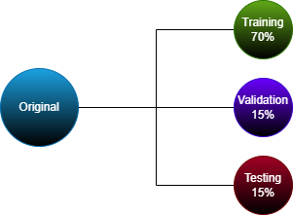
Methodology
1. Preprocessing (cont’d)
Fig 3: Data split (70% training, 15% validation, and 15% testing)
For model training and evaluation, the dataset is stratified by family to preserve class distribution.
Stratified split ensures balanced representation of malware families across all subsets, and minimizes bias toward dominant classes.
27/10/25
ACB-TriNet: Asymmetric Convolutions and Triplet Attention for Effective Malware Classification
19

Slide 20
Methodology
2. Asymmetric Convolution Block (ACB)
The Asymmetric Convolution Block (ACB) replaces the standard 3×3 kernel with three parallel asymmetric kernels: 3 × 3, 1 × 3, and 3 × 1 [7].
These parallel filters capture both horizontal and vertical directional features while maintaining low computational cost.
The outputs of the three convolutions are summed and followed by:
Batch Normalization (BN)
GELU activation
During inference, all asymmetric kernels are merged into a single 3×3 equivalent kernel, preserving efficiency.
This structure improves the network’s ability to detect texture, orientation, and boundary patterns in malware images.
27/10/25
ACB-TriNet: Asymmetric Convolutions and Triplet Attention for Effective Malware Classification
20

Slide 21
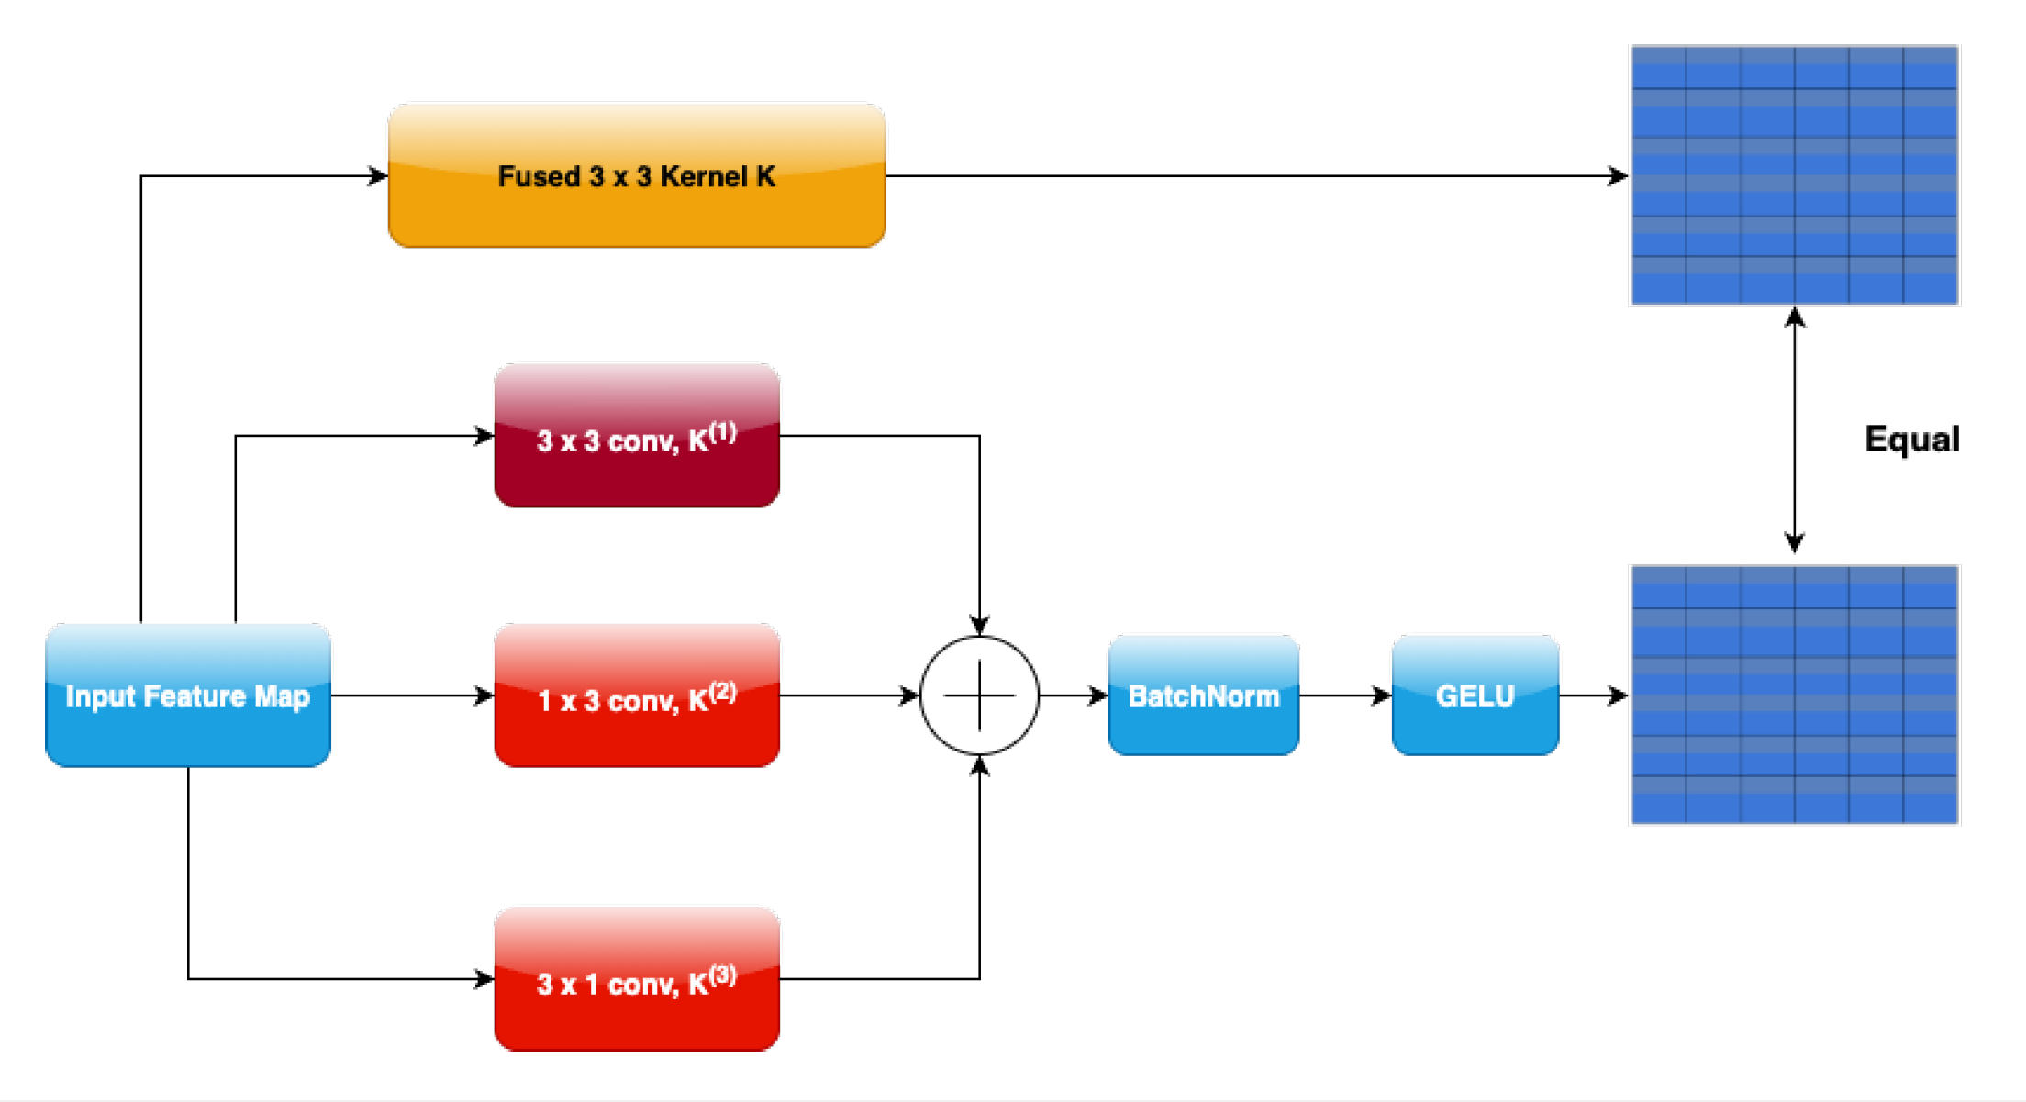
Methodology
2. Asymmetric Convolution Block (ACB) (cont’d)
Fig. 4. Architectural diagram of the Asymmetric Convolution Block (ACB).
27/10/25
ACB-TriNet: Asymmetric Convolutions and Triplet Attention for Effective Malware Classification
21

Slide 22
Methodology
3. Triplet Attention Mechanism
Traditional attention modules (CBAM, BAM) compute spatial and channel attention separately, missing critical cross-dimensional interactions.
Triplet Attention jointly models relationships among height (H), width (W), and channel (C) dimensions by applying a shared lightweight operator to three tensor permutations [8].
Working Principle:
Compute ZPool(X) by concatenating max- and mean-projections across channels to capture both salient and average activations.
Apply a 7 × 7 convolution + Batch Norm + Sigmoid to form an attention mask A(X).
Process three tensor views – (H,W), (W,H), and (C,H) – each gated by its mask.
Average the three refined outputs → final attention-weighted tensor Y<sub>triplet</sub>.
Advantages:
Captures cross-channel–spatial dependencies missed by 2-D attention.
Enhances feature selectivity in malware visualization tasks.
Lightweight → minimal computational overhead.
27/10/25
ACB-TriNet: Asymmetric Convolutions and Triplet Attention for Effective Malware Classification
22

Slide 23
Methodology
4. Dual-Branch Architecture
The proposed ACB-TriNet model employs a dual-branch CNN architecture to effectively learn both low-level texture and high-level semantic features from malware images.
Branch A – Residual Feature Extractor:
Built upon ResNet-style bottleneck blocks integrated with Asymmetric Convolution Blocks (ACB) and Triplet Attention.
Learns directional and cross-spatial information.
Produces fine-grained, texture-sensitive features.
Branch B – VGG-Style Feature Extractor:
Sequential 3×3 convolutions with max-pooling.
Captures global structural and semantic representations.
Lightweight and parameter-efficient.
Feature Fusion Module:
Outputs from both branches are concatenated and passed through a Global Attention Block (GAB) for refinement.
Followed by Fully Connected (FC) and Softmax layers for classification into 25 malware families.
27/10/25
ACB-TriNet: Asymmetric Convolutions and Triplet Attention for Effective Malware Classification
23

Slide 24
Methodology
5. Proposed Model: ACB-TriNet Architecture
The proposed ACB-TriNet integrates Asymmetric Convolution Blocks (ACB) and Triplet Attention within a dual-branch CNN framework for robust malware image classification.
Combines directional feature learning, cross-dimensional attention, and class-balanced optimization [6].
Designed to be lightweight (2.1M parameters) and interpretable.
Key Components
Input:
3-channel malware images (Grayscale, Entropy, Sobel). Size: 32×32×3.
Feature Extraction:
Dual-Branch Design:
Branch A: ResNet-style with ACB + Triplet Attention.
Branch B: VGG-style stacked 3×3 convolutions.
Feature Fusion:
Outputs concatenated and refined using a Global Attention Block (GAB).
Enhances discriminative representation.
Classification:
Fully Connected → Softmax Layer → 25 Malware Families.
Trained using Class-Balanced Focal Loss + DRW to handle imbalance.
27/10/25
ACB-TriNet: Asymmetric Convolutions and Triplet Attention for Effective Malware Classification
24

Slide 25
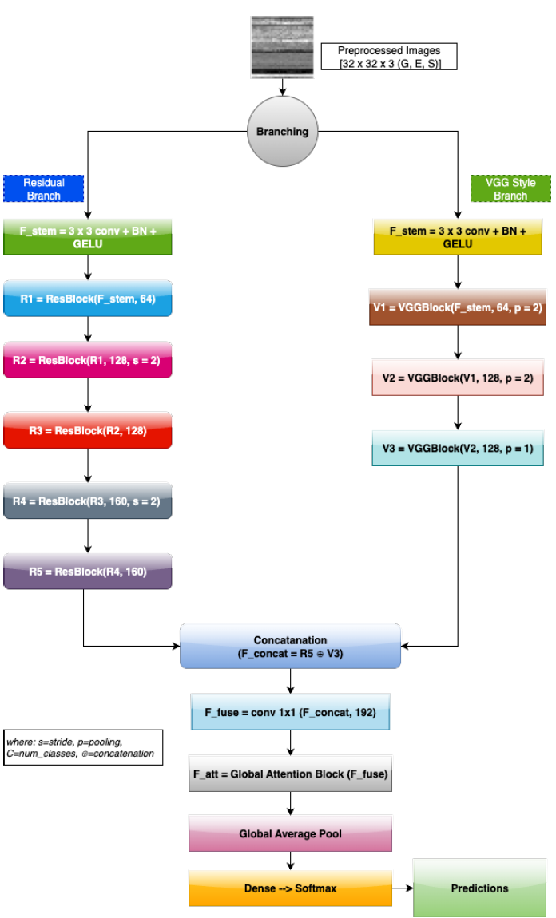
Methodology
5. Proposed Model: ACB-TriNet Architecture (cont’d)
Fig. 5. Overview of the proposed ACB-TriNet.
27/10/25
ACB-TriNet: Asymmetric Convolutions and Triplet Attention for Effective Malware Classification
25

Slide 26
Experimental Setup
Hardware & Environment
Processor: Intel® Core™ i7-13700K (3.4 GHz)
GPU: NVIDIA RTX 4070 (12 GB VRAM)
RAM: 32 GB DDR5
Framework: PyTorch 2.0.1
OS: Ubuntu 22.04 LTS
Training Parameters
Optimizer: Adam
Learning Rate: 0.001 (decayed by 0.1 every 30 epochs)
Batch Size: 32
Epochs: 150
Loss Function: Class-Balanced Focal Loss
Regularization: Dropout (0.5) and Weight Decay (1e−4)
Imbalance Handling: Deferred Re-Weighting (DRW)
Evaluation Metrics
Accuracy (ACC)
Precision (P)
Recall (R)
F1-Score (F1)
False Negative Rate (FNR)
27/10/25
ACB-TriNet: Asymmetric Convolutions and Triplet Attention for Effective Malware Classification
26

Slide 27
Results Analysis
1. Overview
This section presents the experimental outcomes and evaluation of the proposed ACB-TriNet model.
Our analysis demonstrates that the combination of Asymmetric Convolution Blocks (ACB), Triplet Attention, and a Global Attention Block (GAB) results in state-of-the-art accuracy, robustness, and interpretability for malware family classification using the Malimg dataset.
27/10/25
ACB-TriNet: Asymmetric Convolutions and Triplet Attention for Effective Malware Classification
27

Slide 28
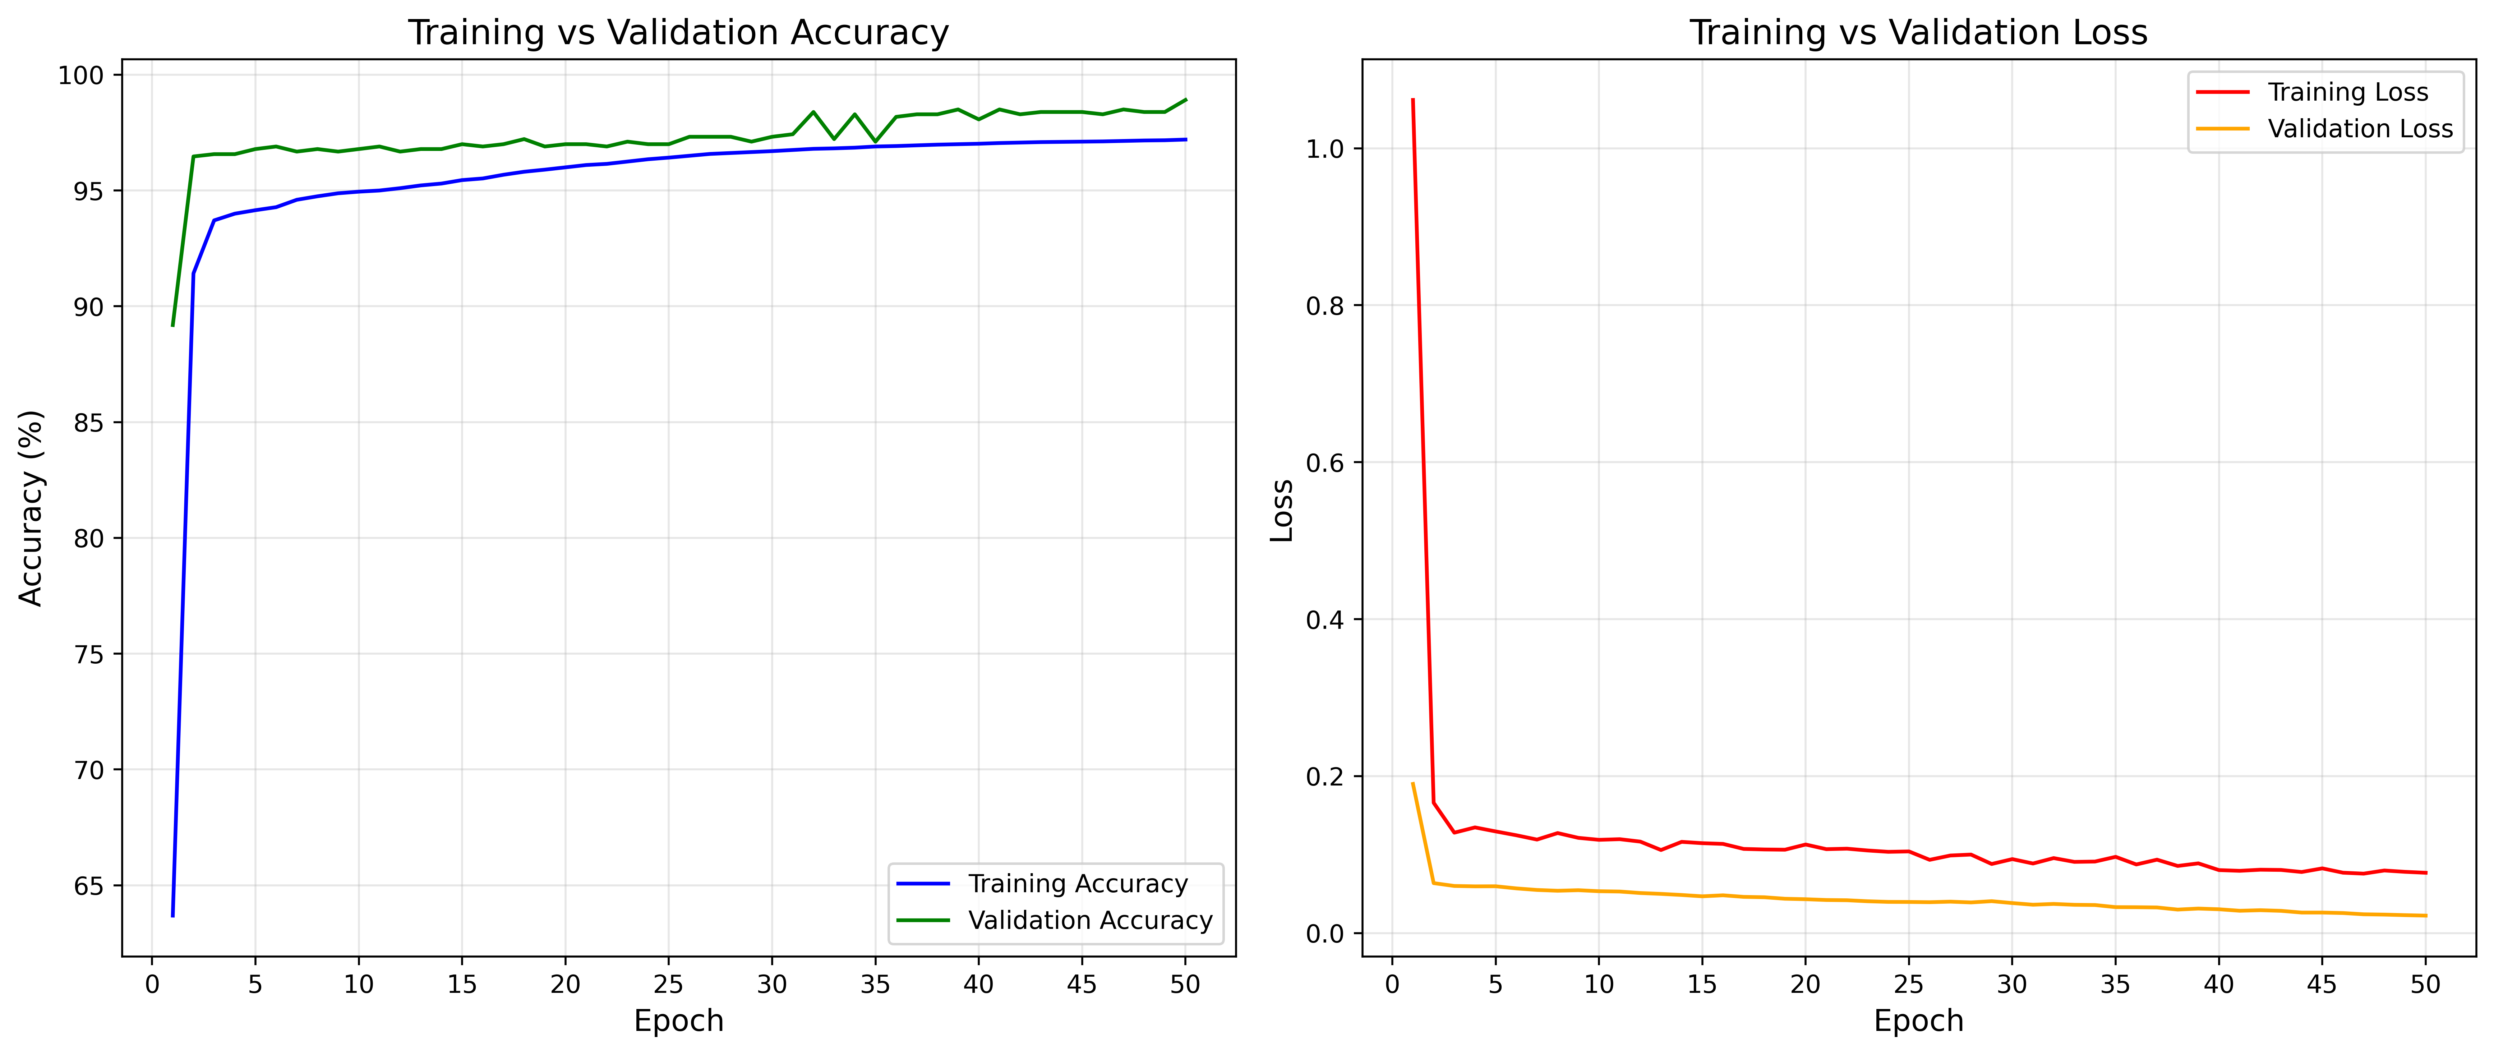
Results Analysis
2. Model Training and Validation Performance
Model trained for 50 epochs using AdamW optimizer (lr = 3×10⁻⁴) and Deferred Re-Weighting (DRW).
Focal Loss (γ = 2) used to handle class imbalance and focus on hard examples.
Training stabilized rapidly, showing excellent convergence:
Training Accuracy: ≈ 97%
Validation Accuracy: ≈ 98%
Validation Loss: ≈ 0.05 (lower than training, indicating good generalization)
Indicates minimal overfitting and stable optimization.
Fig. 5. Training and validation accuracy and loss curves.
27/10/25
ACB-TriNet: Asymmetric Convolutions and Triplet Attention for Effective Malware Classification
28

Slide 29
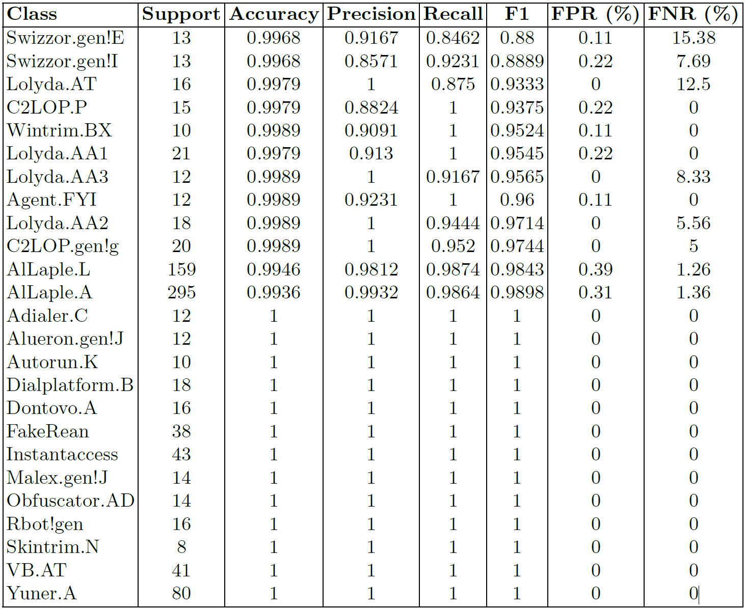
Results Analysis
3. Performance by Malware Family
Table 1 summarizes results across 25 malware families.
Several classes achieve perfect accuracy, precision, recall, and F1-score — notably Adialer.C, Autorun.K, and FakeRean.
Slight reductions in F1 score appear for Swizzor.gen!E (F1 = 0.88) and Swizzor.gen!I (F1 = 0.89) due to high structural similarity.
False Negative Rate (FNR): 2.28% — critical for minimizing missed detections.
False Positive Rate (FPR): 0.07%, reducing false alerts.
Table 2. Comparison of performance metrics for various malware detection methods.
27/10/25
ACB-TriNet: Asymmetric Convolutions and Triplet Attention for Effective Malware Classification
29

Slide 30
Results Analysis
4. Overall Model Effectiveness
The proposed ACB-TriNet model achieves consistently high performance:
Accuracy: 98.98%
Precision: 98.95%
Recall: 98.90%
F1-Score: 98.81%
False Positive Rate: 0.07%
False Negative Rate: 2.28%
These results confirm strong generalization and reliability across all malware categories.
Fig. 6. Overall results on validation data. Left axis: Accuracy, Precision, Recall, and
F1 (in %). Right axis: error rates (FPR, FNR).
27/10/25
ACB-TriNet: Asymmetric Convolutions and Triplet Attention for Effective Malware Classification
30

Slide 31
Results Analysis
5. Confusion Matrix Analysis
Confusion matrix shows excellent diagonal dominance, indicating accurate classification across all 25 malware families.
Misclassifications primarily occur between Swizzor.gen!E and Swizzor.gen!I, which are polymorphic variants.
Demonstrates strong differentiation even between visually similar malware samples.
Fig. 7. Confusion matrix showing the classification results for all malware families.
27/10/25
ACB-TriNet: Asymmetric Convolutions and Triplet Attention for Effective Malware Classification
31

Slide 32
Results Analysis
6. ROC Curve Evaluation
ROC curves evaluate trade-offs between true-positive and false-positive rates.
The proposed model achieves a macro AUC of 0.9998.
21 malware families reached AUC = 1.0, and the rest > 0.998.
Indicates almost perfect separability between malware families.
Fig. 8. ROC curves depicting the model’s performance across 25 malware families.
27/10/25
ACB-TriNet: Asymmetric Convolutions and Triplet Attention for Effective Malware Classification
32

Slide 33
Results Analysis
7. Precision–Recall Curve Evaluation
PR curves emphasize performance on minority classes.
Macro Average Precision (AP): 0.9898.
17 families achieved AP = 1.0 (perfect precision–recall balance).
Slight precision degradation for Swizzor.gen!E (AP = 0.886) and Swizzor.gen!I (AP = 0.921).
Confirms consistent detection capability across imbalanced data.
Fig. 9. Precision-recall curves for classification across all families.
27/10/25
ACB-TriNet: Asymmetric Convolutions and Triplet Attention for Effective Malware Classification
33

Slide 34
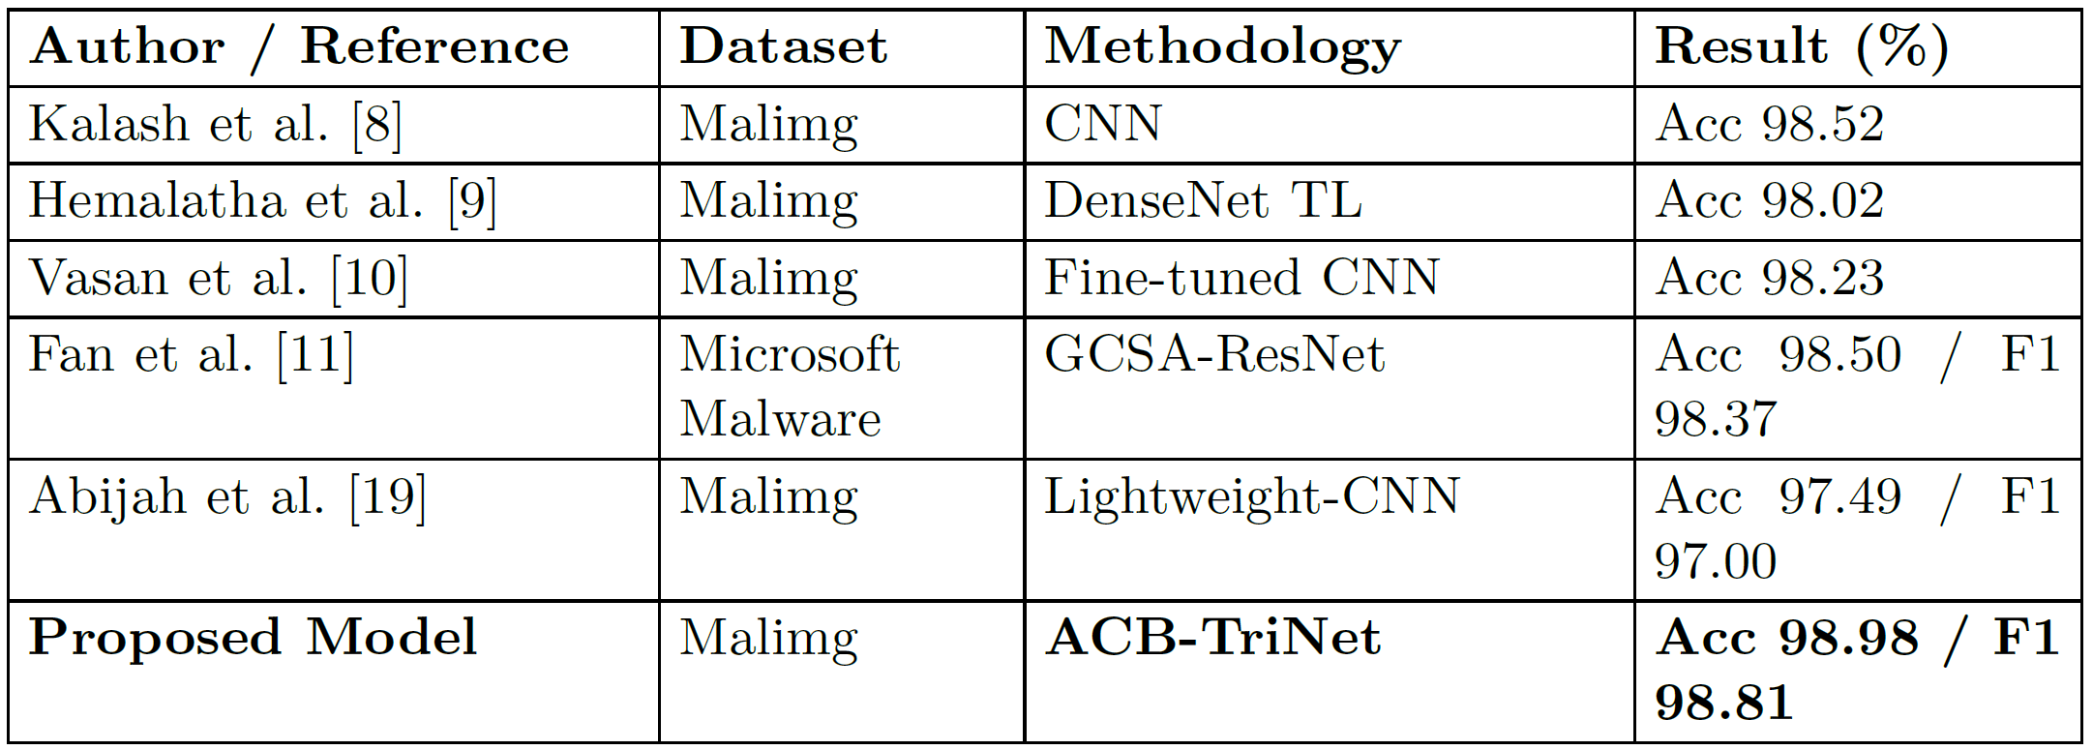
Results Analysis
8. Comparison with Existing Studies
Table 3. Comparison with other studies on malware family classification.
ACB-TriNet surpasses all previous architectures, owing to the synergy between asymmetric convolution, triplet attention, and global feature fusion.
27/10/25
ACB-TriNet: Asymmetric Convolutions and Triplet Attention for Effective Malware Classification
34

Slide 35
Results Analysis
9. Interpretation of Model Behavior
Grad-CAM visualizations highlight discriminative regions in malware images.
ResNet branch: captures global hierarchical structures.
VGG branch: captures local fine-grained textures (e.g., obfuscation patterns).
Fusion combines both to yield a comprehensive representation.
Fig. 10. Dual-branch feature extraction and fusion. Panels: (a) three-channel input image, (b) ResNet branch highlighting global hierarchical structure, (c) VGG branch emphasizing local textures, (d) fused representation after concatenation and reduction, and (e) final decision map with confidence.
27/10/25
ACB-TriNet: Asymmetric Convolutions and Triplet Attention for Effective Malware Classification
35

Slide 36
Results Analysis
10. Attention Mechanisms Visualization
The visualization demonstrates how the network refines focus progressively:
ACB: Captures horizontal and vertical malware structures.
Triplet Attention: Models cross-dimensional interactions (height, width, channels).
GAB: Selects most informative spatial regions for final decision.
Produces highly concentrated attention on family-specific code patterns, improving interpretability.
Fig. 11. Attention mechanism visualizations. Rows: (a) ACB with multi-directional
kernels (3×3, 1×3, 3×1); (b) Triplet Attention across channel–height, channel–width,
and height–width views; (c) GAB combining channel attention and spatial attention
to produce a refined decision map.
27/10/25
ACB-TriNet: Asymmetric Convolutions and Triplet Attention for Effective Malware Classification
36

Slide 37
Results Analysis
11. Key Findings from the Results Analysis
High Accuracy & Reliability: 98.98% accuracy, 98.81% F1-score.
Low Error Rates: FPR = 0.07%, FNR = 2.28%.
State-of-the-Art Performance: Outperforms all previous CNN and attention-based models.
Interpretability: Grad-CAM and attention maps reveal how the model identifies key discriminative regions.
Efficiency: Only ~2.1 million parameters — significantly lighter than ResNet-50 or DenseNet-121.
27/10/25
ACB-TriNet: Asymmetric Convolutions and Triplet Attention for Effective Malware Classification
37

Slide 38
Conclusion & Future Works
Proposed ACB-TriNet, a dual-branch CNN for malware family classification using the Malimg dataset.
Utilizes three-channel representations (grayscale, entropy, Sobel edge) to capture diverse structural and textural features.
Combines Asymmetric Convolution Blocks (ACB), Triplet Attention, and a Global Attention Block (GAB) to learn both global and local patterns.[7, 8]
Achieved 98.98 % accuracy and 2.28 % false negative rate, ensuring reliable malware detection.
Grad-CAM visualizations confirm interpretable feature focus and transparent decision-making.[13]
Future work includes zero-day detection, dynamic behavior analysis, adversarial robustness, lightweight edge deployment, and cross-dataset evaluation for real-world generalization.
27/10/25
ACB-TriNet: Asymmetric Convolutions and Triplet Attention for Effective Malware Classification
38

Slide 39
References
Symantec Threat Report (2023). Global Malware Statistics.
Nataraj, L., Karthikeyan, S., Jacob, G., & Manjunath, B. S. (2011). Malware Images: Visualization and Automatic Classification. Proceedings of the 8th International Symposium on Visualization for Cyber Security (VizSec).
Kalash, M., Rochan, M., Mohammed, N., Bruce, N. D. B., Wang, Y., & Muhammad, M. (2018). Malware Classification Using Deep Convolutional Neural Networks. IFIP International Conference on New Technologies, Mobility and Security (NTMS).
Agarap, A. F., & Ramos, J. D. (2018). Malware Classification Using Artificial Neural Networks on Raw Bytes and N-grams. arXiv:1802.10135.
Vinayakumar, R., Soman, K. P., & Poornachandran, P. (2020). Deep Learning for Malware Analysis and Classification. Computers & Security, 92, Article 101760.
Cui, Y., Jia, M., Lin, T.-Y., Song, Y., & Belongie, S. (2019). Class-Balanced Loss Based on Effective Number of Samples. IEEE/CVF Conference on Computer Vision and Pattern Recognition (CVPR).
27/10/25
ACB-TriNet: Asymmetric Convolutions and Triplet Attention for Effective Malware Classification
39

Slide 40
References
7. Ding, X., & Zhang, X. (2023). ACNet: Asymmetric Convolution Networks for Improved Representations. IEEE Transactions on Pattern Analysis and Machine Intelligence (TPAMI).
8. Misra, D., Nalamada, T., Arasanipalai, A. U., & Hou, Q. (2021). Triplet Attention for Parameter-Efficient Image Classification. IEEE Winter Conference on Applications of Computer Vision (WACV).
AV-Test Institute. (2025). Malware Statistics & Trends Report.
Ahmed, I. T., Rahman, F., & Karim, M. R. (2024). Comparative Analysis of Texture-Based Malware Detection. IEEE Access.
Nath, H. V., & Mehtre, B. M. (2014). Static Malware Analysis Using Machine Learning Methods. Springer.
Selvaraju et al. (2017) – Grad-CAM: Visual Explanations from Deep Networks, ICCV
27/10/25
ACB-TriNet: Asymmetric Convolutions and Triplet Attention for Effective Malware Classification
40

Slide 41
THANK YOU
You are welcome to ask any questions
27/10/25
ACB-TriNet: Asymmetric Convolutions and Triplet Attention for Effective Malware Classification
41

